Slide 1
Certificates of Insurance Review

Slide 2
What is the goal?
Keeping insurance premiums down
Intent of the insurance policy
Controlling our risk

Slide 3
Goals of the contract
Transfer of risk to the appropriate party
Risk arising out of our operations as ECS versus risk arising out of the contractors operations
Protection for ECS

Slide 4
What to look for in contracts
ECS listed as additional insured
Provides coverage to other individuals or groups that were not initially named in the policy.
Hold Harmless/Indemnification language
A hold harmless clause is used as a release of liability in a contract that protects one party from injury or property damage caused by another party. By signing the clause, the other party is agreeing not to hold business owners legally responsible for the risks involved in certain services.
Waiver of Subrogation
A Waiver of Subrogation is an endorsement that prohibits an insurance carrier from recovering the money they paid on a claim from a negligent third party. An Owner Client may require this endorsement from their vendors to avoid being held liable for claims that occur on their jobsite.

Slide 5
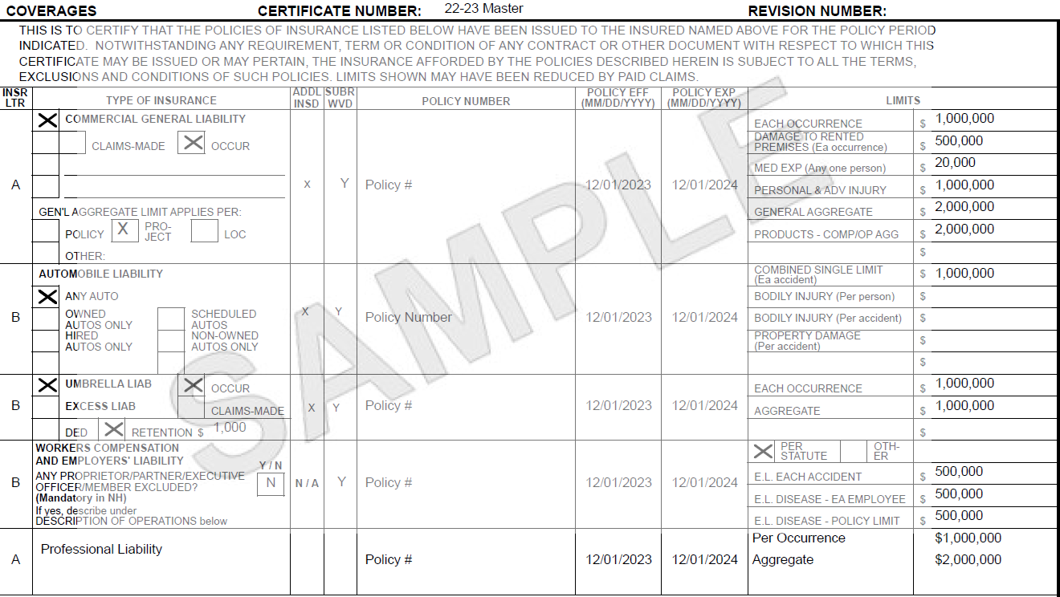

Slide 6
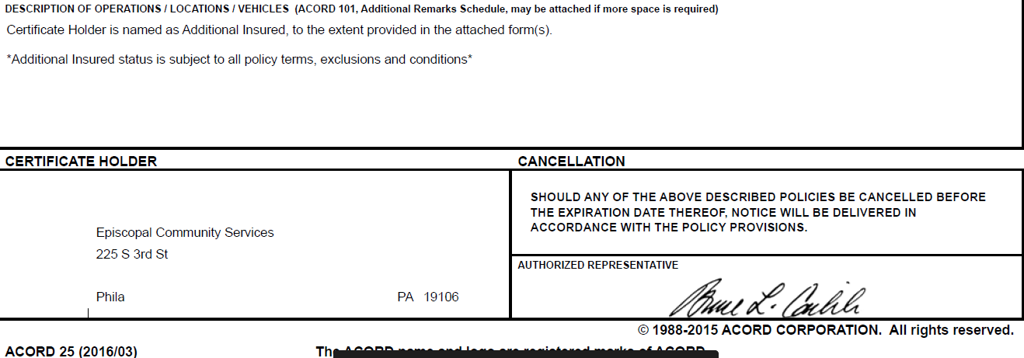
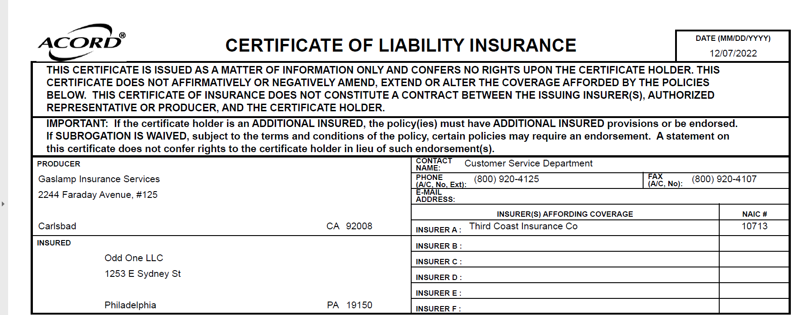
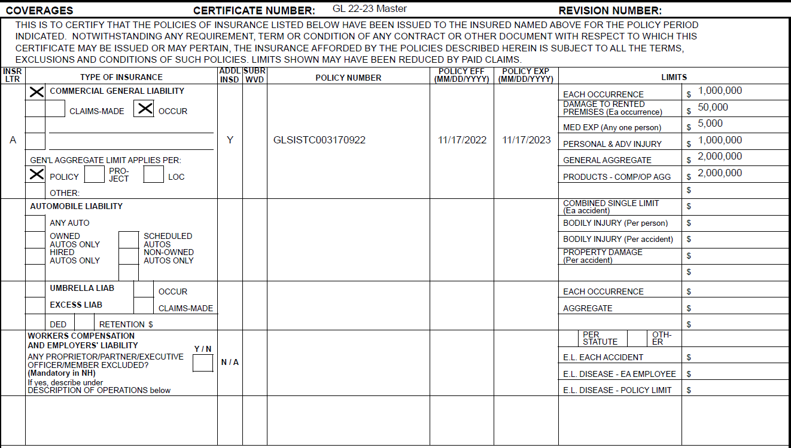

Slide 7
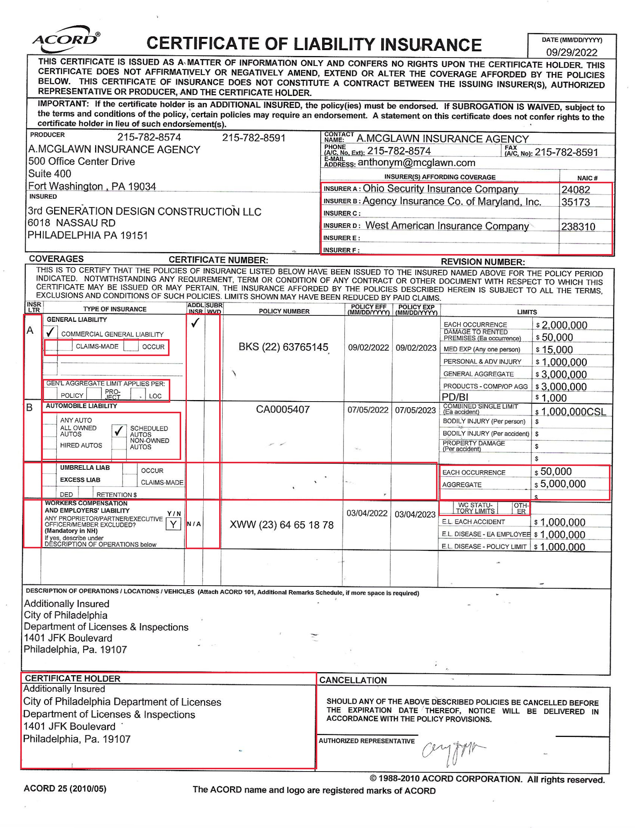
What to Look Out For….

Slide 8
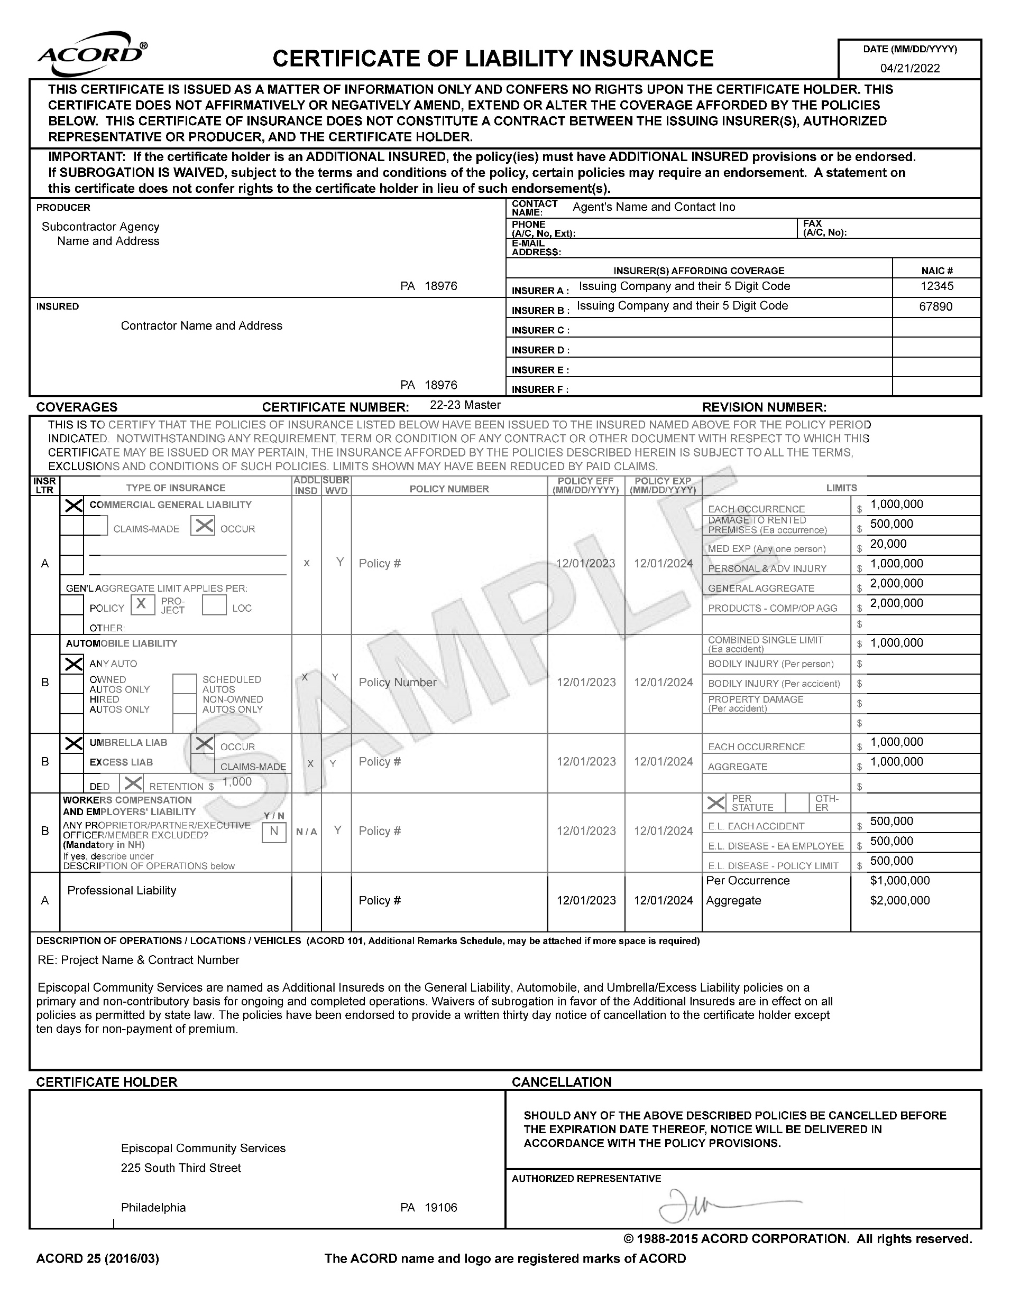
What You Should Receive…

